Slide 1
20XC15-Problem Solving and C Programming

Slide 2
Outline
C - Character Set
Tokens
  Identifiers
  Keywords
  Constants
  Operators
  Special symbols
Data types
Variables

Slide 3
Steps in Learning C Language
Steps in learning English language
Alphabets
Words
Sentence
Paragraphs
Steps in learning C language
Alphabets
Digits
Special Symbol
Constant
Variable
Keyword
Instruction
Program

Slide 4
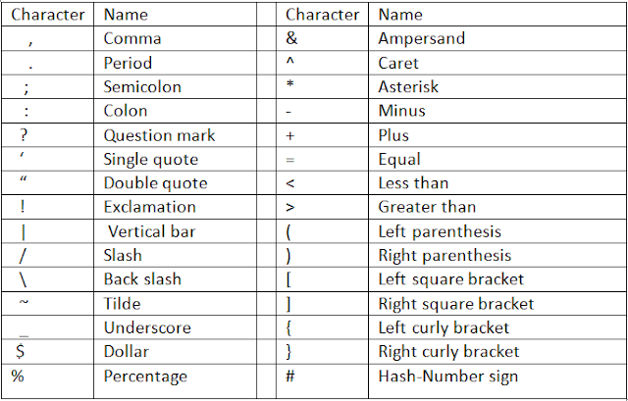
C - Character Set
Like every other language, 'C' also has its own character set
The C character set consists of
  Upper (A-Z) and lower case(a-z) alphabets
  Digits (0-9)
  White spaces (Blanks, New lines, Horizontal and vertical tabs, etc.)
  Special characters

Slide 5
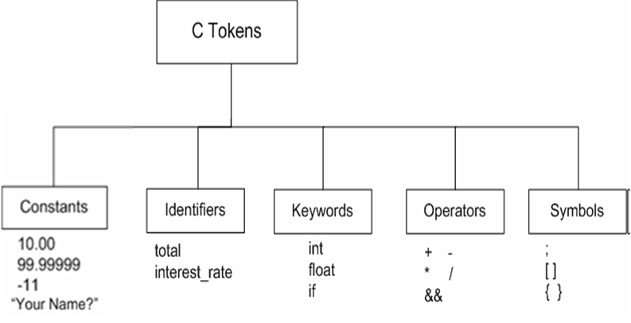
C Tokens
The smallest element identified by the compiler in a source file - token
  It may be a single character or a sequence of characters to form a single item

Slide 6
C Tokens - Identifiers
Identifiers - names that are given to various program elements such as variables, functions, symbolic constants and arrays
In a C program, every word is either classified as an identifier or a keyword
There are certain rules regarding identifier names
  Identifier names consist of letters and digits, in any order, except that the first character must be a letter
    Examples : Sum result1 number2 interest a123
  Case sensitive – Upper and lowercase letters are not interchangeable
    ie., an uppercase letter is not equivalent to the corresponding lowercase letters
    Example : A variable named ‘TOTAL’ is not the same as the variable named ‘total’

Slide 7
C Tokens - Identifiers
  The underscore character ( _ ) can also be included, and is considered to be a letter
    It is often used in the middle of an identifier. An identifier may also begin with an underscore.
  Examples: simple_interest _sum1 number1_
Keywords cannot be used as programmer defined identifiers
  ie., the identifier name should not be a keyword of C
An identifier should contain enough characters so that its meaning is readily apparent
  An excessive number of characters should be avoided
  ie., The first 31 characters are significant in any ANSI C compiler

Slide 8
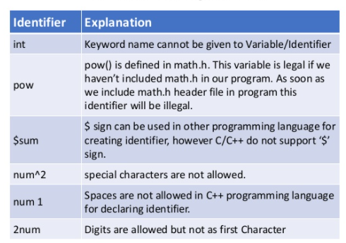
C Tokens - Identifiers
Examples of Invalid identifiers

Slide 9
C Tokens - Keywords
Certain reserved words - called keywords, that have standard predefined meanings in C
These keywords can be used only for their intended purpose; they cannot be used as programmer defined identifiers
Keywords are always written in lowercase letters
32 words - defined as keywords in C
auto | double | int | struct
break | else | long | switch
case | enum | register | typedef
char | extern | return | union
const | float | short | unsigned
continue | for | signed | void
default | goto | sizeof | volatile
do | if | static | while

Slide 10
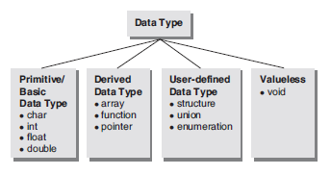
Data types
A data type is a set of values and a set of operations on those values
Data type determines
  The possible values (range of values) for that type
  The operations that can be done on values of that type
Knowledge of the data type of an item (a variable or value) enables the C compiler to correctly specify operations on that item

Slide 11

Primitive Data types
The C language supports five primitive data types
  integers (int)
  floating point numbers (float)
  double precision floating point numbers (double)
  characters (char)
  void (void)
The basic data types can be modified by adding special keywords called data type modifiers to produce new features or new types
ie., data type modifiers used to change the current properties of data type
Data type modifiers are classified into the following types
  short, long, signed, unsigned
    Size specifiers - short and long
    Sign specifiers - signed and unsigned
Note: The data type void does not have these modifiers

Slide 12
Primitive Data types
  Size specifiers - prefixed with basic data types to modify (either increase or decrease) the amount of storage space allocated to a variable
  Sign specifiers
    Signed - allows to store negative or positive values
    unsigned - allows to store only positive values in the given data type (int and char)

Slide 13
Primitive Data types
Data type Data type Modifier
signed
unsigned
signed char
unsigned char
char
short int
long int
signed int
unsigned int
signed short int
signed long int
unsigned short int
unsigned long int
short
long
signed
unsigned
int
double
long
long double
Note : signed is default modifier of int and char data types if no modifier is specified
For example: int a; (or) signed int a;
No modifier is applicable for float data type

Slide 14
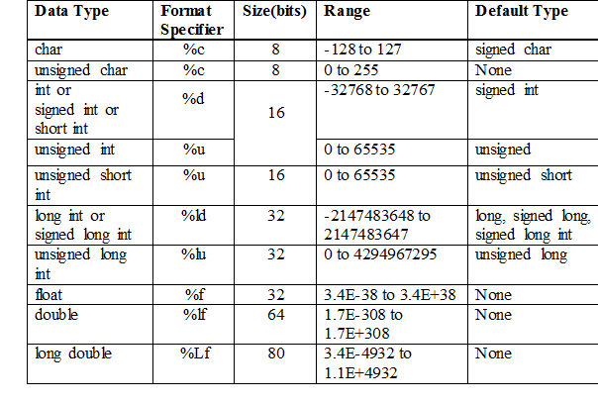
Primitive Data types
char and int data types
signed = -2^{n-1} to 2^{n-1}-1 [ 1 bit for storing sign(0 for +ve, 1 for –ve)]
unsigned = 0 to 2^{n}-1, where n is the total number of bits
Note: C numeric ranges are platform dependent!

Slide 15
Min and Max values of Data Types
limits.h header file – defines sizes of integral types
  This header defines the following constants with the limits of fundamental integral types for the specific system and compiler implementation used
    CHAR_BIT = number of bits in a char
    SCHAR_MIN = minimum value for a signed char
    SCHAR_MAX = maximum value for a signed char
    UCHAR_MAX = maximum value for an unsigned char
    CHAR_MIN = minimum value for a char
    CHAR_MAX = maximum value for a char
    SHRT_MIN = minimum value for a short
    SHRT_MAX = maximum value for a short
    USHRT_MAX = maximum value for an unsigned short
    INT_MIN = minimum value for an int
    INT_MAX = maximum value for an int
    UINT_MAX = maximum value for an unsigned int
    LONG_MIN = minimum value for a long
    LONG_MAX = maximum value for a long
    ULONG_MAX = maximum value for an unsigned long
    LLONG_MIN = minimum value for a long long
    LLONG_MAX = maximum value for a long long
    ULLONG_MAX = maximum value for an unsigned long long

Slide 16
Example
#include <stdio.h>
#include <limits.h>
int main() {
printf("The number of bits in a byte %d\n", CHAR_BIT);
printf("The minimum value of SIGNED CHAR = %d\n", SCHAR_MIN);
printf("The maximum value of SIGNED CHAR = %d\n", SCHAR_MAX);
printf("The maximum value of UNSIGNED CHAR = %d\n", UCHAR_MAX);
printf("The minimum value of SHORT INT = %d\n", SHRT_MIN);
printf("The maximum value of SHORT INT = %d\n", SHRT_MAX);
printf("The minimum value of INT = %d\n", INT_MIN);
printf("The maximum value of INT = %d\n", INT_MAX);
printf("The minimum value of CHAR = %d\n", CHAR_MIN);
printf("The maximum value of CHAR = %d\n", CHAR_MAX);
printf("The minimum value of LONG = %ld\n", LONG_MIN);
printf("The maximum value of LONG = %ld\n", LONG_MAX);
return(0);
}
Output:
The number of bits in a byte 8
The minimum value of SIGNED CHAR = -128
The maximum value of SIGNED CHAR = 127
The maximum value of UNSIGNED CHAR = 255
The minimum value of SHORT INT = -32768
The maximum value of SHORT INT = 32767
The minimum value of INT = -2147483648
The maximum value of INT = 2147483647
The minimum value of CHAR = -128
The maximum value of CHAR = 127
The minimum value of LONG = -9223372036854775808
The maximum value of LONG = 9223372036854775807

Slide 17
Min and Max values of Data Types
float.h header file – defines the limits for float and double data types
  -FLT_MAX = most negative value of a float
  FLT_MAX = max value of a float
  -DBL_MAX = most negative value of a double
  DBL_MAX = max value of a double
  -LDBL_MAX = most negative value of a long double
  LDBL_MAX = max value of a long double

Slide 18
Number Representation
Fundamental problem
  Fixed-size representation (e.g. 4 bytes for integers) can’t encode all numbers
    Usually sufficient in most applications
    But a potential source of bugs: overflow
Other problems
  How to represent negative numbers, floating points?
    Historically, many different representations

Slide 19
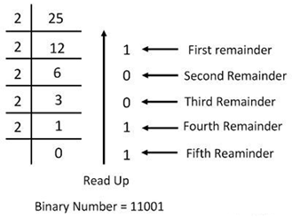
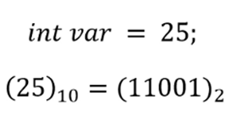
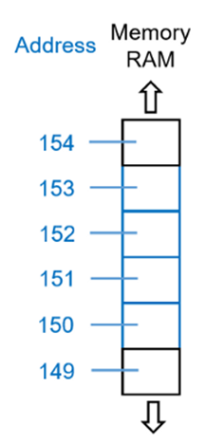
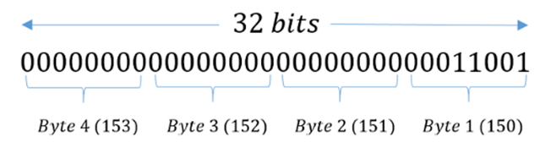
Number Representation

Slide 20
Number Representation
Unsigned integer numbers
0 0 0 0 0 0 0 0 ≡ 0 //8-bit binary representation of positive integers
0 0 0 0 0 0 0 1 ≡ 1
0 0 0 0 0 0 1 0 ≡ 2
0 0 0 0 0 0 1 1 ≡ 3
...
1 1 1 1 1 1 1 1 ≡ 255
MSB – Most Significant Bit
LSB – Least Significant Bit
Signed Integer Number Representation
  Sign-Magnitude Representation
  1’s complement Representation
  2’s complement Representation

Slide 21
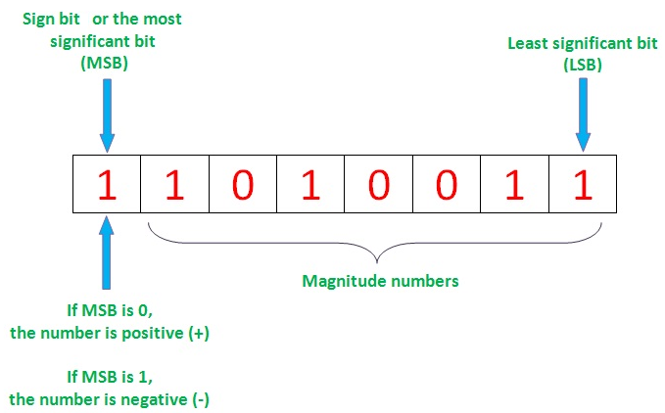
Number Representation
Sign/Magnitude representation (also called “signed representation”)
  use one of the bits (the first bit = Most Significant Bit) as a sign bit
  use the rest for magnitude
  e.g.
      000 = +0
      001 = +1
      010 = +2 positive numbers
      011 = +3
      100 = -0
      101 = -1
      110 = -2 negative numbers
      111 = -3
Range: -(2 ^{(n-1)}-1) to (2 ^{(n-1)} -1), where n is the total number of bits
For n = 4, [ -(2³-1) . . . 2³-1 ]
[ -7 . . . 7 ]

Slide 22
Number Representation
Computers don’t use a “sign and magnitude” representation
  Drawbacks of the Sign-Magnitude representation
    two 0’s: one positive one negative
    addition and subtraction involving negative numbers are complicated
Alternatives?
  1's complement representation
  2's complement representation: today's standard
These two representations seem very similar in approach, but they differ in:
  Representation of negative numbers (positives are the same in all 3 representations) and
  Ease of arithmetic operations involving negative numbers

Slide 23
Number Representation
Signed numbers: 1’s complement
  Positive numbers: first bit is 0, and the rest is the binary equivalent of the number.
  Negative numbers: represented by the 1’s complement of the corresponding positive number
    1’s complement: invert all the bits (0's become 1; 1's become 0)
    e.g +8 = 0000 1000 (0 for + sign, and 000 1000 for 8)
    - 8 = 1111 0111
  So, effectively the first bit is used for sign, but negative numbers show a distinction from those of the sign-magnitude representation

Slide 24
Number Representation
Number 1’s-complement
+7 0111
+6 0110
+5 0101
+4 0100
+3 0011
+2 0010
+1 0001
+0 0000
-0 1111
-1 1110
-2 1101
-3 1100
-4 1011
-5 1010
-6 1001
-7 1000
As in the sign/magnitude representation,
there is + and - 0's
Range: [-(2^{n-1}-1) . . 2^{n-1}-1]
For n = 4, [-(2³-1) . . . 2³-1 ]
[-7 . . . 7]

Slide 25
Number Representation
Signed 2’s complement
  common representation for signed numbers used in computers
  For positive numbers, use 0 first and the remaining bits are the binary equivalent of the magnitude
  Negative numbers are represented by the 2’s complement of the corresponding positive number
    2’s complement
      Invert all bits and add 1
      Alternative (easier) method: copy all the bits from right to left until and including the first 1, invert the rest)
        Ex : +20 = 0001 0100
        -20 = 1110 1100
        0 0 0 1 0 1 0 0 - 20 in binary form
        --------------------
        1 1 1 0 1 0 1 1 - 1’s complement
        1 +
        ------------------------
        1 1 1 0 1 1 0 0 - 2’s complement

Slide 26
Signed numbers: 2’s complement
Number 2’s-complement
+7 0111
+6 0110
+5 0101
+4 0100
+3 0011
+2 0010
+1 0001
0 0000
-1 1111
-2 1110
-3 1101
-4 1100
-5 1011
-6 1010
-7 1001
-8 1000
Range: [-2^{n-1} . . . 2^{n-1}-1]
For n = 4, [-2³ . . . 2³-1 ]
[-8 . . . 7 ]
There is only one zero
There is one more negative number as compared to positives
  Note:
  Single 0
  Addition and subtraction complexities simplified
  Note the range (one more negative as compared to 1's complement): -2 ^{(n-1)} ... (2 ^{(n-1)} -1)
  Current standard for representing signed integers

Slide 27

Subtraction
a-b can always be represented as a+(-b). Doing the arithmetic in this way causes wrong results in sign-multitude and 1's complement representations, but not in 2's complement.
Consider 3 - 2 which is the same as 3 + (-2)
In sign-magnitude representation using 4 bits:
3 + (-2) should give 1, but instead we get -5 !
0 011 = +3₁₀
1 010 = -2₁₀ (Binary form of 2 is 0010 in four bits)
+-------------
1101 = -5₁₀ which is a wrong result
To remedy this, the operation can take special notice of the sign bits and perform a subtraction instead. This complicates the implementation; we have a better solution using 2's complement (next slide).

Slide 28
Subtraction
In 1's complement representation using 4 bits
3 + (-2) becomes 0 !
0 011 = +3₁₀
1 101 = -2₁₀ (Binary form of 2 is 0010 in four bits)
+---------
1 0 000 = 0₁₀ which is a wrong result
But 2's complement addition results in the correct sum without hassle
0 011 = +3₁₀
1 110 = -2₁₀
+---------
1 0 001 = 1₁₀ which is the correct result!
We got rid of it automatically since it does not fit
We got rid of it automatically since it does not fit

Slide 29
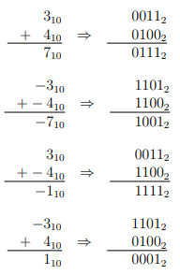
2’s Complement Form
Even when the signs are different, the
two’s complement representation of the sum
is correctly obtained
We can add two integers using simple
adder hardware, when using two’s complement
representation

Slide 30
Possible Representations: Summary
Sign Magnitude One's Complement Two's Complement
000 = +0 000 = +0 000 = +0
001 = +1 001 = +1 001 = +1
010 = +2 010 = +2 010 = +2
011 = +3 011 = +3 011 = +3
100 = -0 100 = -3 100 = -4
101 = -1 101 = -2 101 = -3
110 = -2 110 = -1 110 = -2
111 = -3 111 = -0 111 = -1
Note: Positive numbers are represented the same way (same bit strings) in all
representations! So for all three representations, representation of a
positive number is directly decimal to binary / binary to decimal
conversion

Slide 31
Why 2's Complement?
There is only one zero. Range for negative numbers is one more than the other representations
Positive number represented in same way as other two methods. Negative number obtained by taking 1's Complement of positive number and adding 1
Subtraction can be implemented as addition (a - b = a + -b). Thus, no borrowing logic needs to be implemented. Consider the two 8-bit examples
97 - 120 =? -51 – 70 = ?
01100001 → 97 11001101 → -51
10001000 → -120 10111010 → -70
+------------- +-------------
11101001 → -23 110000111 → -121
Due to fixed width of the registers, carry overflow is lost automatically but the result is correct

Slide 32

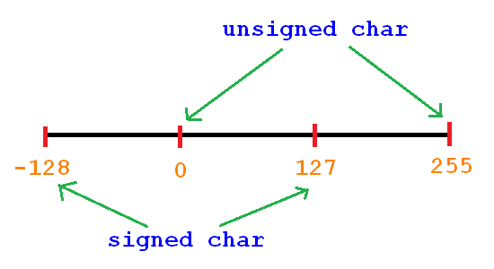
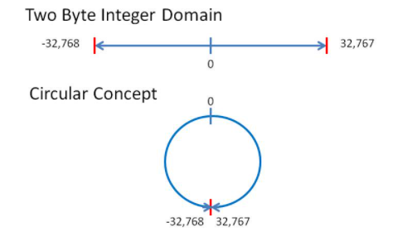
Overflow
Since each data type occupies fixed amount of memory, there is a fixed maximum value it can store (range of values)
When an attempt is made to store a value greater than this maximum value it is known as an overflow
In languages like C, integer overflow reliably wraps around
e.g., UINT_MAX + 1 yields zero

Slide 33
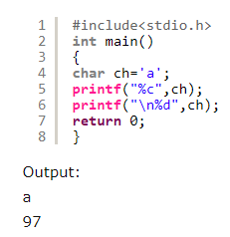
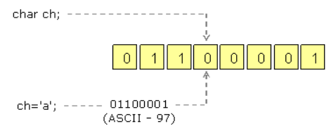
Overflow – char datatype
How a character is stored in char type?

Slide 34
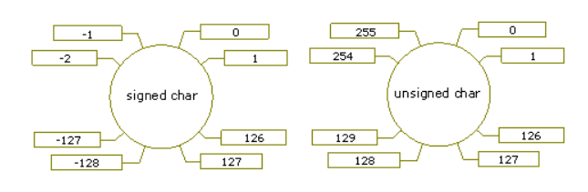
Overflow
Sign bit
Signed char - range -> -128 to 127
Unsigned char - range ->0 to 255
Binary value of 127 - 1111111
Binary value of 128 – 10000000 (8-bits) – no space to sign information Hence, it can’t be stored in 8-bits
Representation of -128
7 6 5 4 3 2 1 0
0 | 1 | 1 | 1 | 1 | 1 | 1 | 1
7 6 5 4 3 2 1 0
1 | 0 | 0 | 0 | 0 | 0 | 0 | 0
1 x 2⁷ = 128
Since the sign bit is 1, it is considered as -128

Slide 35
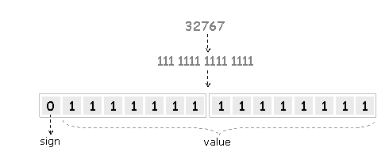
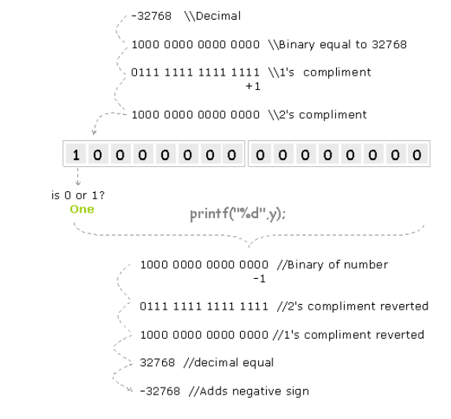
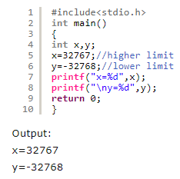
Integer Overflow

Slide 36
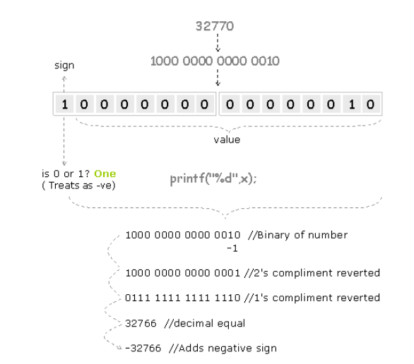
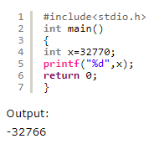
Integer Overflow

Slide 37
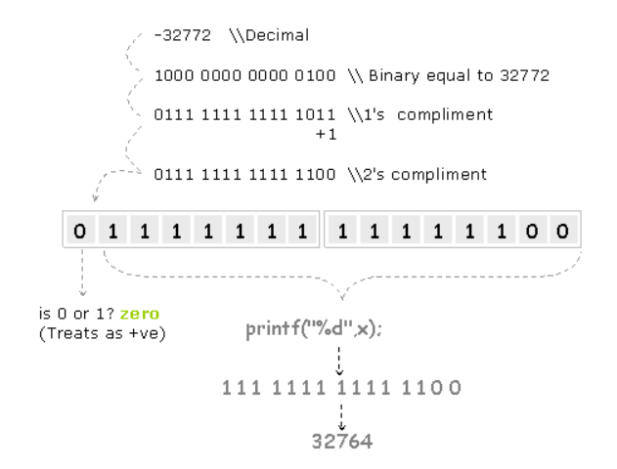
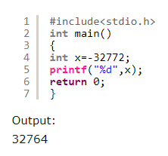
Underflow

Slide 38
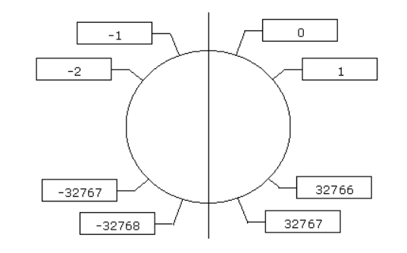
Summary of Overflow and Underflow
Any data type has a range according to the bytes of memory that it takes
Assigning a value that is more than it’s higher limit result wrapping towards negative side called overflow
Assigning a value that is less than it’s lower limit result wrapping towards positive side called underflow

Slide 39
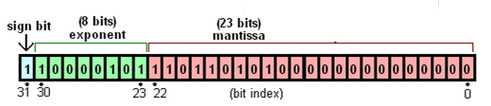
Floating Point Representation
We need a way to represent
  numbers with fractions, e.g., 3.1416
  very small numbers, e.g., .000000001
  very large numbers, e.g., 3.1 x 10²⁰
Solution: A floating (decimal) point representation
IEEE 754 floating point representation is the standard

Slide 40
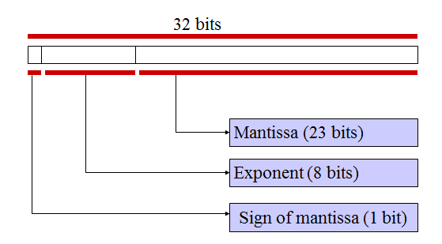
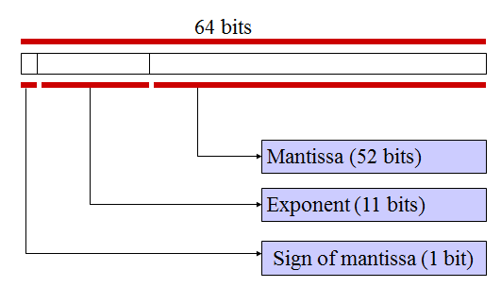
Floating Point Representation
Most common standard for representing floating point numbers
Single precision: 32 bits, consisting of
  Sign bit (1 bit)
  Exponent (8 bits)
  Mantissa (23 bits)
Double precision: 64 bits, consisting of
  Sign bit (1 bit)
  Exponent (11 bits)
  Mantissa (52 bits)

Slide 41
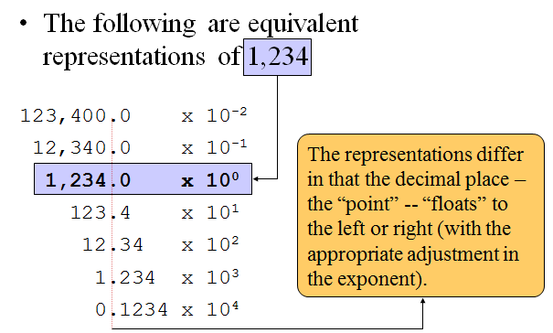
Exponential (or) Scientific Notation
Compact Notation : 6.626068 x 10⁻³⁴ = .00000000000000000000000006626068

Slide 42
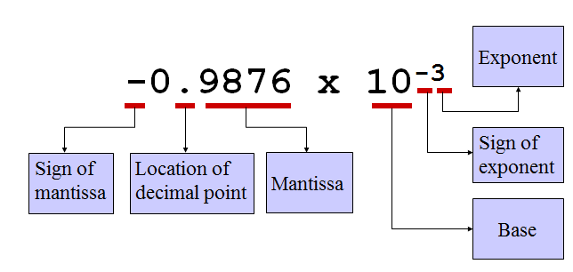
Exponential Notation
-0.9876e-3 (or) -0.9876E-3

Slide 43
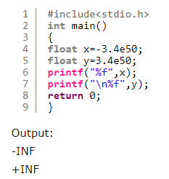
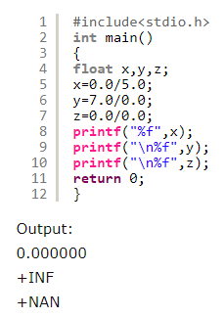
Overflow and Underflow in floating point types
In case of integer types overflow results wrapping towards negative side, underflow results wrapping towards positive side
In floating point types
  Overflow results +INF and
  Underflow results –INF
  0/0 returns a floating point constant +NAN (Not a Number)

Slide 44
Type Qualifiers
Type qualifiers - control how variables may be accessed or modified
C89 defines two of these qualifiers: const and volatile
Type qualifiers must precede the data type names that they qualify
const
  Variables of type const can’t be changed by your program
  A const variable is given an initial value - The compiler is free to place variables of this type into read-only memory (ROM)
  For example : const int num=10;
    creates an integer variable called num with an initial value of 10 that your program may not modify
  The const qualifier can be used to prevent the modification on the value of the variable num

Slide 45
Type Qualifiers
volatile
  tells the compiler that a variable's value may be changed in ways not explicitly specified by the program
  volatile int local=10;
  For example
    A global variable's address may be passed to the operating system's clock routine and used to hold the system time
    In this situation, the contents of the variable are altered without any explicit assignment statements in the program
  Objects declared as volatile are omitted from optimization by the compiler because their values can be changed by code outside the scope of current code at any time
  const and volatile together can be used in the defining a variable
  const volatile int local = 10;
  The value of the variable ‘local’ can be modified only by an external
  means and not by the program.

Slide 46
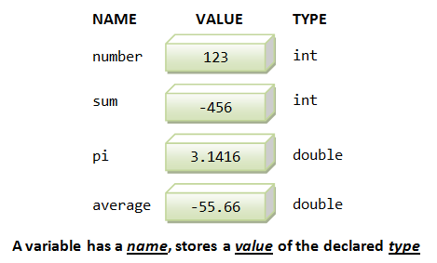
Variables
A variable is an identifier(name) for a memory location in which data can be stored and subsequently recalled
  More precisely, a variable is a named storage location, that stores a value of a particular data type. In other words, a variable has a name, a type and stores a value.

Slide 47
Variables
A variable has a value that can be changed during the execution of the program.
Programmers refer to a variable by its name (identifier) so that it can be accessed during the course of the program.
Programmers cannot use any of the keywords as variable names
In C, a variable must be defined before it can be used
  Variable names are identifiers. They are symbolic names given to memory locations.
  A variable name consists of sequence of letters and digits, and the first character being a letter. The rules apply to identifiers also apply to variable names
Valid variable names are
  i rank1 MAX1 min class_mark
  Stud_name emp_num Mark product

Slide 48
Variables
Invalid variable names
  a’s - Illegal character(‚)
  fact value - blank not allowed
  5roots - first character should be a letter
  Student,recq - comma not allowed
Defining Variables
  In order to use a variable in C, the programmer must first define it specifying the data type.
  Syntax to define a new variable
typename varname;
typename varname1, varname2, ...;
    typename – name of any built-in data type
    Varname, varname1, varname2 - identifiers

Slide 49
Defining Variables
Examples
  int year;
  float total;
  unsigned int index_no;
  short int number_of_students;
Multiple variables belonging to the same data type can be defined as separate set of expressions or by listing variable names one after the other (should be separated by a coma sign (,))
Consider the following examples:
  int num1;
  int num2;
  float total;
  float sub_total;
Above variables can also be defined as
  int num1, num2;
  float total, sub_total;

Slide 50

Declaration Vs Definition
Declaration
  Tells the compiler about the entity type and name
  Does not allocate memory
    It can be done more than once
    Example
      extern int sum; /* external variable declaration */
      float square (float); /* function prototype declaration */
Definition
  Allocates memory for the variable
  It can be done only once
  Example
    int number1;
    double distance;
Notes:
For automatic and register variables, there is no difference between definition and declaration

Slide 51
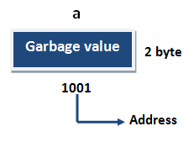
Initializing a variable
After defining a variable it should be initialized with a suitable value
In C, an uninitialized variable can contain any garbage value therefore the programmer must make sure all the variables are initialized before using them in any of the expressions
For example : int a;
Initializing a variable can be done while defining it, just after defining it or later within the code (before accessing/evaluating its value within an expression)

Slide 52
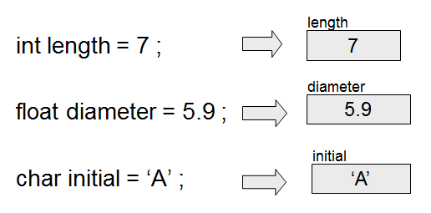
Initializing a variable
Variables may be given initial values, or initialized, when defined
Syntax
  datatype variablename = value/expression;

Slide 53
Assignment
Variables may have values assigned to them through the use of an assignment statement
Such a statement uses the assignment operator =
This operator does not denote equality. It assigns the value of the right hand side of the statement (the expression) to the variable on the left hand side
Syntax
  datatype variablename;
  …..
  variablename = value/expression;
Examples:
float diameter, area;
diameter = 5.9 ;
area = length * width ;

Slide 54
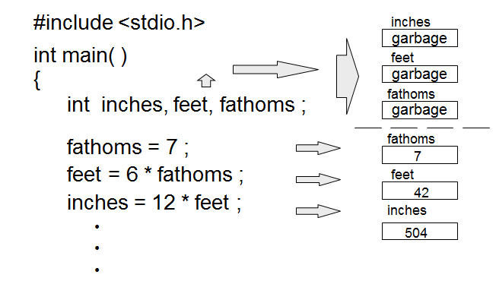
Example: Definitions and Assignments

Slide 55
Initialization Vs Assignment
Initialization
  Variables can be initialized in the definition statement (Initialization gives a variable an initial value at the point when it is created)
  Initialization a variable is only done exactly once
    Example : int num=10;
Assignment
  Assignment gives a variable a value at some point after the variable is created
  Assignment can be done many times
  Example : int num1;
  ….
  num1=10;
  ….
  num1=20;

Slide 56
Why is initialization needed?
Initialization is needed to provide initial values to const variables
const is a type qualifier - a keyword applied to a data type that indicates that the data is read only
The const qualifier only gives the direction to the compiler that the value of qualify object cannot be changed. In simple words, const means not modifiable
Syntax : const data_type Identifier = Value;
Example
    int const p = 100, a; /* p is set to 100 and is read-only */
      p is set to 100 and is read-only and a is set to 0 by default and is read-only since a is also a const variable
    const int p = 100; /* p is set to 100 and is read-only */
    const float pi = 3.14159; /* pi is a constant. read only */
    …..
    pi = pi+1; //error

Slide 57
C Tokens
The smallest element identified by the compiler in a source file - token
  It may be a single character or a sequence of characters to form a single item

Slide 58
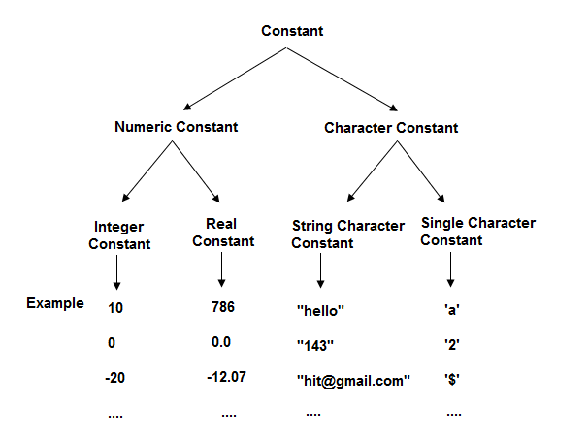
Constants
Constants are data values that cannot be changed during the execution of the program.
There are four basic types of constants in C

Slide 59
Constants – Numeric Constants
Integer Constants
  integer valued number
  consists of sequence of digits
  It can be written in three different number systems
    Decimal (base 10) -%d
    Octal (base 8) and -%o
    Hexadecimal (base 16) -%x (letters will print in lowercase)
    (or) %X (letters will print in uppercase)
Rules in writing integer constants
  No spaces and commas are allowed
  It can be +ve/-ve but by default it is +ve
  No fractional part

Slide 60
Constants – Numeric Constants
C understands as decimal, octal or hexadecimal according to the prefix we supply
  int x, y, z;
  x=456; /* treats it as decimal number*/
  y=0456; /* treats it as octal number */
  z=0x456; /*treats it as hexadecimal */
In C language printf() and scanf() are so intelligent so that they automatically convert from one system to another according to the formatting characters we use
Example 1
#include<stdio.h>
int main() {
int a=10;
printf("%d\n%o\n%x\n%X",a,a,a,a);
return 0;
}
Output:
10
12
a
A

Slide 61
Constants – Numeric Constants
Example 2
#include<stdio.h>
int main() {
printf("%d\n%d\n%d\n%d",10,12,0xa,0XA);
return 0;
}
Note :
x=456;
Variable names are said to be lvalues (for “left values”) because they can be used on the left side of an assignment operator
Constants are said to be rvalues (for “right values”) because they can be used only on the right side of an assignment operator
Lvalues can also be used as rvalues, but not vice versa
Output
10
12
10
10

Slide 62
Constants – Numeric Constants
Decimal Integer Constant
  It consists of any combination of digits taken from the set 0 through 9 (0, 1, 2, 3, 4, 5, 6, 7, 8, 9 (base 10)). If the constant contains two or more digits, the first digit must be something other than 0
    int a = 4569;
    printf("%d \n %o \n %x \n %X",a,a,a,a);
Valid decimal integer constants
  0 1 234 5278 32767 9999
Invalid decimal integer constants
12,245 Illegal character (,)
10 20 30 Illegal character (blank space)
123-45-89 Illegal character (-)
0700 The first digit cannot be zero (valid
octal integer constant)

Slide 63
Constants – Numeric Constants
Octal Integer Constant
  It consists of any combination of digits taken from the set 0 through 7 (0, 1, 2, 3, 4, 5, 6, 7 (base 8))
  The first digit must be 0, in order to identify the constant as an octal number
  int y = 0456;
Valid octal integer constants
  0 01 07436 07777
Invalid octal integer constants
  743 does not begin with 0
  05280 Illegal digit (8)
  077.67 Illegal character (.)

Slide 64
Constants – Numeric Constants
Hexadecimal Integer Constant
  A hexadecimal Integer Constant must begin with either 0x or 0X. It can be followed by any combination of digits taken from the set 0 through 9 and a through f(either upper-or lowercase)
  The letters a through f (or A through F) represent the (decimal) quantities 10 through 15 respectively
  int z=0x45A;
Valid hexadecimal integer constant
  0x 0X1 0X7FFF 0Xabcd
Invalid hexadecimal integer constant
  0X 12.34 Illegal character (.)
  0BE38 Does not begin with 0x or 0X
  0x.4bff Illegal character (.)
  0XDEFG Illegal character (G)

Slide 65
Constants – Numeric Constants
Note :
  We can also explicitly mention the type of the constant by suffixing it with l or L(for long int), u or U( for unsigned int), ul or UL ( for unsigned long), LL or ll (for long long int), ull or uLL (for unsigned long long int)
  Examples
  55138722UL or 55138722ul - Integer constant of type unsigned long int
  6675U or 6675u - Integer constant of type unsigned int
  900000000001ull - Integer constant of type unsigned long long int
  long int x = 10000L * 409600L; //correct
Notes:
https://stackoverflow.com/questions/13134956/what-is-the-reason-for-explicitly-declaring-l-or-ul-for-long-values

Slide 66
Constants – Numeric Constants
Example
  #include<stdio.h>
  int main()
  {
  long int r1, r2;
  r1 = 10000 * 409600;
  printf(“\n%ld”, r1);
  r2 = 10000L * 409600L;
  printf(“\n%ld”, r2);
  return 0;
  }
Output:
-198967296
4096000000

Slide 67
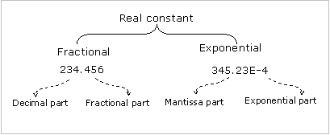
Constants – Floating Point Constants
Floating point (real) constants have a decimal point or an exponent sign or both

Slide 68
Constants – Floating Point Constants
Decimal or Fractional Notation
  The number is represented as a whole number followed by decimal point and fractional part.
  It is possible to omit digits before or after the decimal part
    Example: 241. .976 -.71 +.5
Rules for real constants in fractional form
  It must be a number
  It can be either +ve or –ve but by default it is a positive number
  It must have one decimal point
  No commas and spaces are used in a number

Slide 69
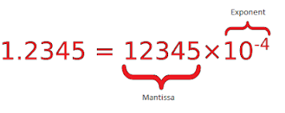
Constants – Floating Point Constants
Exponential (or) Scientific Notation
  Exponential notation is useful in representing numbers whose magnitudes are very large or very small.
  The exponential notation consists
    mantissa and
    exponent
  The rules governing exponential representation of real constants
      The mantissa is either a real number expressed in decimal notation or an integer
      The mantissa can be preceded by a sign
      The exponent is an integer preceded by an optional sign
      The letter ‘e’ can be written in either uppercase or lowercase
      Embedded white space is not allowed

Slide 70
Constants – Floating Point Constants
  The exponent is positive unless preceded by a minus sign
  Consider the number 231.78
    This can also be written as 0.23178e3 representing the number 0.23178*10³
    The sequence of digits 23178 after the decimal point of the number 0.23178 is the mantissa, and 3 is the exponent
  As another example 75000000000 can be written as 75e9 or 0.75e11
  Similarly 0.00000000045 can be written as 0.45e-9
  Valid floating-point constants
  2000.0434 3.4E4 3e8
  Invalid floating-point constants
  3.4E.4 Exponent must be an integer
  3e 8 Blank not allowed

Slide 71
Constants – Floating Point Constants
  Note: By default, real constants are assumed to be double
    Suffixes f or F can be used to specify the float values
    For example
      0.257 is assumed to be a double constant, while 0.257f (or 0.257F) is a float constant
    l or L - used to specify long double values
      Example: 0.257L (or 0.257l) is a long double constant

Slide 72

Constants – Character Constants
Single character constant
A Character constant is a single character, enclosed in apostrophes (Single quotation marks)
  ie., A character constant is an alphabet, a single digit or a single special symbol enclosed within inverted commas. The maximum length of a character constant can be 1 character.
  Example : ‘A’ ‘X’ ‘3’ ‘?’ ‘ ’ (blank space)
Character constants have integer values that are determined by the computer’s particular character set
Most computer’s make use of the ASCII ( American Standard Code for Information Interchange) character set, in which each individual character is numerically encoded with its own unique 7-bit combination. Hence, a total of 2⁷ = 128 different characters
  Note: One or two character(s) can also be enclosed within single quotes. The compiler will report an error, if more than two characters constant are enclosed within single codes

Slide 73
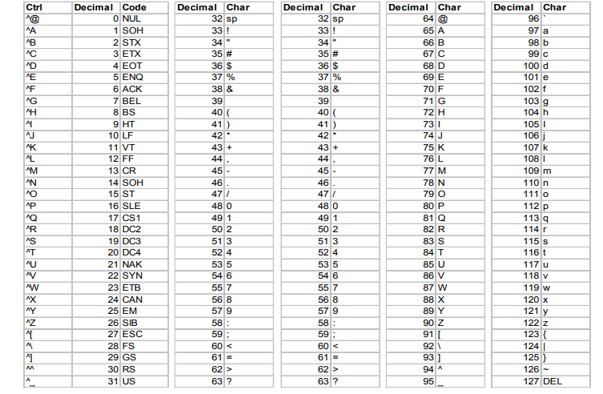
ASCII Character Set

Slide 74
Escape Sequences
Character combinations consisting of a backslash (\) followed by a letter or by a combination of digits are called "escape sequences"
An escape sequence is regarded as a single character and is therefore valid as a character constant
Escape sequences are typically used to specify actions such as carriage returns and tab movements on terminals and printers
  Used in formatting the output and are not displayed while printing text on to the screen, each having its own specific function
They are also used to provide literal representations of nonprinting characters and characters that usually have special meanings, such as the double quotation mark (")

Slide 75
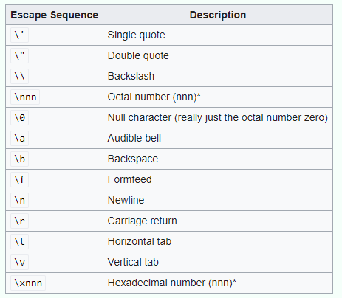
Escape Sequences
* For both Hexadecimal and Octal number escape sequences, \nnn or \xnnn evaluates to a character with character code nnn. For example, \101 evaluates to the character A, as A has the character code of 101 in octal format.

Slide 76
Constants –Character Constants
String constants
  A string constant consists of any number of consecutive characters (including null character), enclosed in (double) quotation marks
  Examples
  “green”
  “ P.S.G. Tech.”
  “270-34-5678”
  “&12.5”
  “ ”

Slide 77
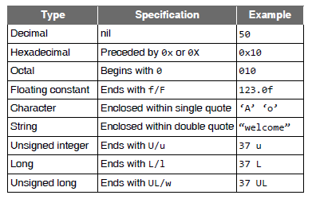
Specifications of Different Constants

Slide 78
Symbolic Constant
The #define preprocessor directive defines a symbolic constant
  Example : #define SIZE 10
A symbolic constant is an identifier that is replaced with replacement text by the C preprocessor before the program is compiled.
When the program is preprocessed, all occurrences of the symbolic constant SIZE are replaced with the replacement text 10
  #include<stdio.h>
  #define VAL 10
  #define FLOATVAL 4.5
  #define CHARVAL 'G'
  int main()
  { printf("Integer Constant: %d\n", VAL);
  printf("Floating point Constant: %.1f\n", FLOATVAL);
  printf("Character Constant: %c\n", CHARVAL);
  return 0; }

Slide 79

Symbolic Constant
Note:
#define SIZE 10;
If the #define preprocessor directive is terminated with a semicolon, all occurrences of the symbolic constant SIZE in the program are replaced with the text 10; by the preprocessor
This may lead to syntax errors at compile time, or logic errors at execution time
Remember - the preprocessor directives are not C statements- it’s only a text manipulator

Slide 80
C Tokens
The smallest element identified by the compiler in a source file - token
  It may be a single character or a sequence of characters to form a single item

Slide 81
Operators
An operator is a symbol which helps the user to command the computer to do a certain mathematical or logical manipulations
Operators are used in C language program to operate on data and variables
C has a rich set of operators which can be classified as
  Arithmetic operators
  Increment and Decrement Operators
  Relational Operators
  Logical Operators
  Assignment Operators
  Conditional Operators
  Bitwise Operators
  Comma Operator

Slide 82
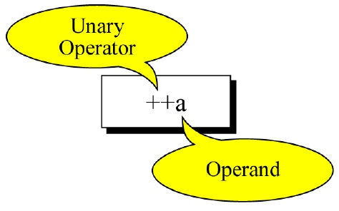
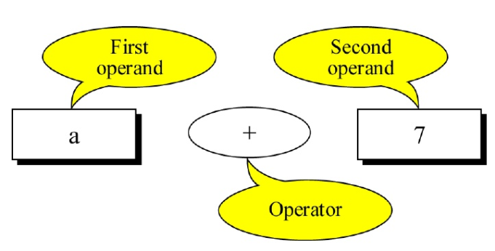
Arithmetic Operators
The arithmetic operators perform arithmetic operations
Classification of Arithmetic Operators
  Unary Operators - Operate on only one operand
  Binary Operators - Operate on two operands
These operators can operate on any built-in
data type
Binary Arithmetic Operators
Operator | Meaning | C Expression
+ | Addition or Unary Plus | num1 +num2
– | Subtraction or Unary Minus | num1 – num2
* | Multiplication | num1 * num2
/ | Division | num1 / num2
% | Modulus Operator (Remainder after division) Can not be used with real operands Logic: x%y=x – (x/y) * y | num1 % num2

Slide 83
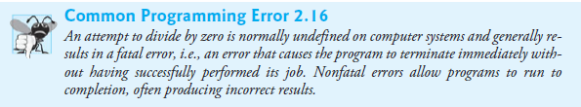
Arithmetic Operators
Note:
  C has no operator for exponentiation. However, a function pow(x,y) exists in math.h which returns x^{y}
  The remainder operator is an integer operator that can be used only with integer operands
  The second operand of division and modulus operators must be a non-zero value

Slide 84
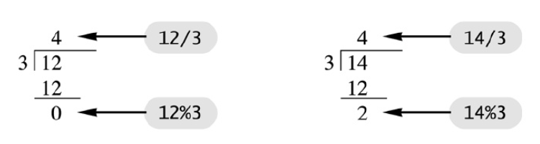

Arithmetic Operators
Note:
  The modulus (remainder) operator - %
  It computes remainder after the first operand is divided by the second
  Examples
    5%2 is 1
    6%2 is 0
For an int variable x

Slide 85
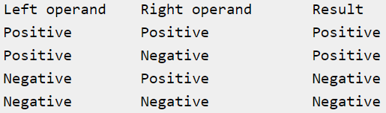
Arithmetic Operators
Note :
Modulus operator with negative numbers
  If we have negative numbers, the result will be based on the left operand's sign
  If the left operand is positive – the result will be positive
  If the left operand is negative – the result will be negative
#include<stdio.h>
int main()
{ printf("%d %d %d %d", 6%5, -6%5, 6%-5, -6%-5); }
Output : 1 -1 1 -1

Slide 86
What is an Arithmetic Expression?
Expression
  An expression is any valid combination of operators, operands (variables or constants)
An arithmetic expression is a syntactically correct combination of numbers, operators (arithmetic), parenthesis, and variables
Examples
    a * ( b + c ) + c * ( d + e )
    y = 2 * 5 * 5 + 3 * 5 + 7
    a + b - c + d
    a * b / c
    1 + a * b % c
    a + d % b - c
    e = b = d + c / b - a

Slide 87
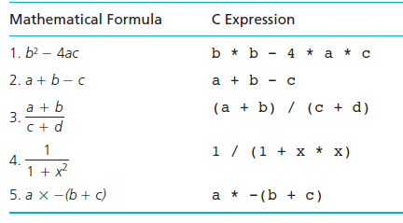
Mathematical Formulas as C Expressions

Slide 88
Precedence and Associativity
Each operator in C has two properties
  Precedence/Priority
    The order in which the operators are evaluated based on the relative priorities
  Associativity
    used when two operators of same precedence appear in an expression
    Direction in which the operators act upon operands (Left to Right or Right to Left)

Slide 89
RECAP Algebra: BEDMAS/PEDMAS Rule
B‐E‐DM‐AS or P‐E‐DM‐AS
  B/P : Bracket or Parenthesis ( )
    In C, only ( ) used for expression
  E : Exponentiation
  DM: Division and Multiplication
  AS : Addition and Subtraction used for expression

Slide 90
BEDMAS Equivalent in C
Arithmetic Operators Precedence Rule
Operator | Precedence and Associativity
() | Evaluated first If nested (embedded), innermost first
* / % | Evaluated second If there are several, evaluated left to right
+ - | Evaluated third If there are several, evaluated left to right
= | Evaluated last, right to left
Note : Use parentheses to change the order in which an expression is evaluated
a + b * c would multiply b * c first, then add a to the result
If you really want the sum of a and b to be multiplied by c, use parentheses to force the evaluation to be done in the order you want
(a + b) * c

Slide 91

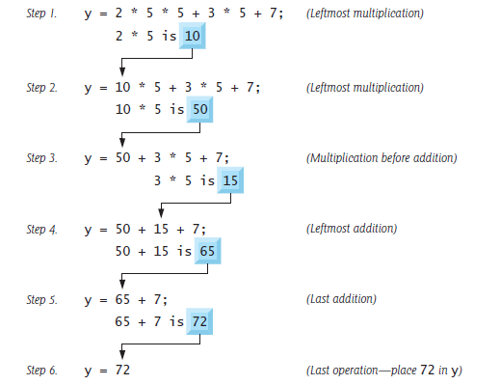
Evaluating Expressions

Slide 92
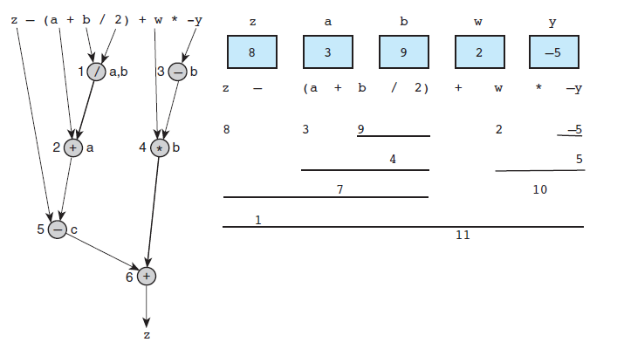
Evaluating Expressions

Slide 93

Practice With Evaluating Expressions
Given integer variables a, b, c, d, and e, where a = 1, b = 2, c = 3, d = 4, evaluate the following expressions
  a + b - c + d
  a * b / c
  1 + a * b % c
  a + d % b - c
  e = b = d + c / b - a

Slide 94
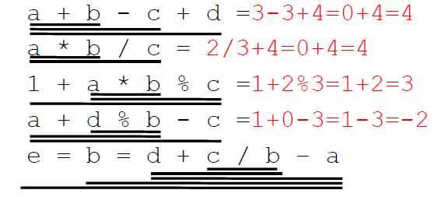
Practice With Evaluating Expressions
Given integer variables a, b, c, d, and e, where a = 1, b = 2, c = 3, d = 4, evaluate the following expressions

Slide 95
Integer Arithmetic
  When an arithmetic operation is performed on two whole numbers or integers than such an operation is called as integer arithmetic
  It always gives an integer as the result
  In integer division the fractional part is truncated
  Example
    Let x = 27 and y = 5 be two integer numbers. Then the integer operation leads to the following results.
    x + y = 32
    x – y = 22
    x * y = 115
    x % y = 2
    x / y = 5

Slide 96
Arithmetic Conversion
Type of value on the right-hand side of the assignment operator is converted to that of the type on the left hand side of it
Types
  (i) Promotion – Conversion of value of a var/constant of lower type to a higher type
int i=20; float x;
x=i; // Promotion
  (ii) Truncation – Discarding the fractional part when real value is converted into integer (Higher to lower)
int i=15.6;
float j;
j=i; // j has only 15.000000
int i;
char ch=’A’;
i=ch; //char converted to int – i has ASCII value
of ‘A’ = 65

Slide 97
Floating Point Arithmetic
When an arithmetic operation is preformed on two real numbers or fraction numbers such an operation is called floating point arithmetic
An operation between two floating point operands always yields a floating point result
The remainder operator (%) is not applicable for floating point arithmetic operands
Examples
Let x = 14.0 and y = 4.0 then
x + y -> 18.000000
x – y -> 10.000000
x * y -> 56.000000
x / y -> 3.500000

Slide 98
Mixed Mode Arithmetic
When one of the operands is real and other is an integer and if the arithmetic operation is carried out on these two operands then it is called as mixed mode arithmetic
If anyone operand is of real type then the result will always be real
Examples
  Let x = 14 and y = 2.5, then
  x + y -> 16.500000
  x - y -> 12.500000
  x * y -> 35.000000
  x / y -> 5.600000
we can use mixed mode arithmetic to solve the problem we encountered while dividing 10/4
  For example, 10/4.0 or 10.0/4 both will give the correct result i.e 2.5

Slide 99
Unary Operators
The unary operators act on a single operand
All unary operators are of equal precedence and have right-to-left associativity
Unary operators in C
  Unary minus (-) and unary plus (+)
  Increment (++) and decrement (- -) (Prefix and Postfix )
  Logical negation (!)
  Address operator (&) and indirection (*)
  Bitwise negation (one's complement) (~)
  Cast operator
  sizeof operator

Slide 100
Unary Plus and Minus
The most common unary operator is unary – (minus) which negates the value of its operand
int a, b=5, c;
a= -b;
c=-(-b);
printf(“%d%d%d”, a, b,c);
Note : It does not change the value of b at the memory where b resides
The unary plus (+) operator returns the value of an expression
Example : a=+ b;
Note : Neither the unary plus nor unary minus operators produce lvalues

Slide 101
Unary Increment and Decrement Operators
In C, specialized operators have been set aside for the incrementing and decrementing of scalar objects.
  Unary increment operator, ++
  Unary decrement operator, --
These operators allow a form of shorthand in C
Prefix form of the increment/decrement operators
Syntax: ++variable (prefix increment)
--variable (prefix decrement)
  ++i; is equivalent to i=i+1;
  --i; is equivalent to i=i-1;
Postfix form of the increment/decrement operators
Syntax: variable++ (postfix increment)
variable-- (postfix decrement)
  i++; is equivalent to i=i+1;
  i--; is equivalent to i=i-1;

Slide 102

Unary Increment and Decrement Operators
Preincrementing (predecrementing) a variable causes the variable to be incremented (decremented) by 1, then the new value of the variable is used in the expression in which it appears
Postincrementing (postdecrementing) the variable causes the current value of the variable to be used in the expression in which it appears, then the variable value is incremented (decremented) by 1

Slide 103

Unary Increment and Decrement Operators

Slide 104
Unary Increment and Decrement Operators
Note:
  Increment and decrement operators can be used only with variables
  They can't be used with constants or expressions
  Example
    int x = 1, y = 1;
    ++x; // valid
    ++(x+y); // invalid - increment operating on an expression
    ++5; // invalid - increment operating on a constant
Precedence: lower than (), but higher than * / and %
Associativity: right to left

Slide 105

Unary Increment and Decrement Operators
Note :
  a++ and ++a are equivalent to a += 1 (a=a+1)
  a-- and --a are equivalent to a -= 1(a=a-1)
  ++a op b is equivalent to ++a; a op b
  a++ op b is equivalent to a op b; a++;
Precedence order

Slide 106


Increment – Prefix and Postfix
Note: Never use postfix and prefix operator at once otherwise it will result in error.
Example : ++a++;
x= ++a-- ;
both results in compilation error

Slide 107
Unary Increment and Decrement Operators
Example 1 : Increment / decrement operators
#include<stdio.h>
main() {
int a =10, b=3,c=4,d=7;
++a; //pre increment operator
b++; //post increment operator
--c; // pre decrement operator
d--; //post decrement operator
printf(“%d %d %d %d”, a, b, c, d);
}
Output
11 4 3 6
Note : Pre incrementing and post incrementing have
same effect if there are no other operations are
involved in an expression

Slide 108

Unary Increment and Decrement Operators
Note:

Slide 109




Unary Increment and Decrement Operators
Example 2 : ++/ -- with = (assignment operator)
#include <stdio.h>
main() { int a =10, b=3,c=4,d=7,x,y,i,j;
x= ++a;
printf(“%d %d”,a,x); // a=11, x=11
y=b++;
printf(“%d %d”,y,b); // y=3, b=4
i=--c;
printf(“%d %d”,c,i); //c=3, i=3
j=d--;
printf(“%d %d”,j,d); // j=7, d=6
}

Slide 110

Comparison of Prefix and Postfix Increments

Slide 111
Unary Increment and Decrement Operators
Example 3
#include <stdio.h>
main()
{
int x=5,y=3,z;
z=++x + ++y;
printf("%d %d %d", x, y, z);
}
Output
6 4 10
Prefix operator returns lvalue and postfix returns constant(rvalue)
x
y
5
3
Order of Evaluation
++y -> y=4
++x -> x=6
x+y -> 6+4
z= (++x + ++y) ->z=10

Slide 112
Unary Increment and Decrement Operators
Example 4
#include<stdio.h>
  main()
  {
  int x=5,y=3,z;
  z=++x + y++;
  printf("%d %d %d",x,y,z); // 6 4 9
  x=5;
  y=3;
  printf("\n%d %d %d",x,y,++x + y++); // 6 4 9
  }
Note: The format specifiers in printf statement are replaced by the value of corresponding variable/constant (argument) from right to left
x
y
5
3
Order of Evaluation
y++ ->3 (increments y to 4)
++x ->x=6
z= ++x + y++ ->6+3 =9

Slide 113
Unary Increment and Decrement Operators
Order of Evaluation
++x (right) ->x=6
++x (left) ->x=7
x+x ->7+7
z= (++x + ++x) ->z=14
Example 5
#include<stdio.h>
void main()
{
int x=5, z;
z=++x + ++x; // x is incremented twice, so, x=7
printf("%d %d",x,z); //7 14
x=5;
printf("\n%d %d",x,++x + ++x); //7 14 or 13 → machine dependent
}
x
5

Slide 114
Unary Increment and Decrement Operators
Example 6
#include<stdio.h>
main() {
int i = 0, j = 0;
j = i++ + ++i;
printf("%d\n", i);
printf("%d\n", j);
}
Output
2
2
i
0
Order of Evaluation
i++ -> 0 (increments i to 1)
++i -> i=2
j= i++ + ++i -> j=0+2

Slide 115
Unary Increment and Decrement Operators
Example 6
#include<stdio.h>
main() {
int i = 0, j = 0;
j = i++ + i++;
printf("%d\n", i);
printf("%d\n", j);
}
Output
2
1
Order of Evaluation
i++ (left ) -> returns 0 (increments i to 1)
i++ (right) -> returns 1 (increments i to 2)
j= 0+1 -> j=1

Slide 116
Unary Increment and Decrement Operators
Example 8
#include<stdio.h>
int main() {
int a=10;
printf("%d\t%d\t%d",--a, a++,++a);
return 0;
}
Output
11 11 11
Because the evaluation is from right to left, ++a increments the value of “a” by 1 and prints (11) , a++ prints (11) the value of “a” and then increments by 1 and – – a decrements the value of “a” by 1 and then printed

Slide 117
Unary Increment and Decrement Operators
Note:
Try not to mix increment/decrement operators with other operators, if possible
Use these operators mostly for its intended purpose
Unexpected behaviors
  Consider i = 2; j = i * i++; //may give j = 6 or i = 4
  int x=4, z;
  z= ++x + ++x + ++x; //may give x=7, z=19
Avoid writing expressions which modify variable within the expression itself

Slide 118
sizeof Operator
This unary operator finds and returns size (number of bytes) of its operand
  The operand may be a variable or constant or expression or data type name
It is a compile time unary operator which can be used to compute the size of its operand
It can be applied to both built-in and user-defined types
Example 1
#include <stdio.h>
  int main()
  { printf("%lu\n", sizeof(char));
  printf("%lu\n", sizeof(int));
  printf("%lu\n", sizeof(float));
  printf("%lu", sizeof(double));
  return 0; }
Output:
1
4
4
8
Note: The result of the sizeof() is machine-dependent

Slide 119
sizeof Operator
Output
Size of 12 is 4 Bytes
Size of ‘a’ is 1 Bytes
Size of 900L is 4 Bytes
Size of 12.45 is 8 Bytes
Size of 12.45f is 4 Bytes
Size of 10+14.50 is 8 Bytes
Size of string is 12 Bytes
Example 2
#include<stdio.h>
int main()
{
printf("Size of 12 is %d Bytes",sizeof(12));
printf("\nSize of 'a' is %d Bytes",sizeof('a'));
printf("\nSize of 900L is %d Bytes",sizeof(900L)); printf("\nSize of 12.45 is %d Bytes",sizeof(12.45)); printf("\nSize of 12.45f is %d Bytes",sizeof(12.45f));
printf("Size of 10+14.50 is %d Bytes",sizeof(10+14.50));
printf(\n Size of string is %d Bytes”,sizeof("Hello World“ ));
return 0;
}

Slide 120
Relational Operators
Compare two similar quantities and depending on their relation, take some decisions
comparisons will have one of the following forms
  variable relational-operator variable
  variable relational-operator constant
  variable equality-operator variable
  variable equality-operator constant
Each of these operators compare their left hand side with their right hand side
The whole expression involving the relational operator then evaluates to an integer (ie., 0 or 1)
Note:
  Relational expressions always reduced to either 0 (expression evaluates to false) or 1(expression evaluates to nonzero, ie., true)

Slide 121

Relational Operators
Note:
  The relational operators all have the same level of precedence and they associate left to right
  The equality operators have a lower level of precedence than the relational operators and they also associate left to right

Slide 122


Relational Operators
Note:
Relational expressions are used in decision making statements of C language such as if, while and for statements to decide the course of action of a running program

Slide 123


Relational Operator
Note: In C language == is different from =
= is an assignment operator which is used to assign a value to the variable
  Example : int b=7;
== is a relational operator used to compare any two values which returns a boolean value either 'true' or 'false'
  Example: 5==5 Condition true Returns 1
  5==6 Condition false, Returns 0

Slide 124

Relational Operator

Slide 125
Logical Operators
To test multiple conditions in the process of making a decision
Used to form more complex conditions or logical expressions by combining simple conditions
Logical Operators
  && (logical AND)
  || (logical OR)
  ! (logical NOT, also called logical negation) - Unary operator
Examples of Logical Expressions
    salary < MIN_SALARY || dependents > 5
    temperature > 90.0 && humidity > 0.90
    n >= 0 && n <= 100
    0 <= n && n <= 100
Binary Operators

Slide 126

Logical Operators
Logical AND (&&) Operator
  yields a true result only when both its operands are true
    Ie., If both the expressions to the left and to the right of the logical operator is true then the whole compound expression is true
Example
  a > b && -10
Note: C accepts any nonzero value as a representation of true

Slide 127

Logical Operators
Logical OR (||) Operator
  The logical OR is used to combine 2 expressions. The condition evaluates to true if any one of the 2 expressions is true
Example
  n1 < m || n1 < n

Slide 128

Logical Operators
Logical Negation (!) Operator
  C provides the ! (logical negation) operator to enable you to “reverse” the meaning of a condition.
  Unlike operators && and ||, which combine two conditions (and are therefore binary operators), the logical negation operator has only a single condition as an operand (and is therefore a unary operator)
Example
  ! (x >= y) the NOT expression evaluates to true only if the value of x is neither greater than or equal to y

Slide 129

Logical Operators

Slide 130

Logical Operators
Short-Circuit Evaluation
  Stopping the evaluation of a logical expression as soon as its value can be determined
Expression1 && expression2
  For an AND operation, if the left operand is false, the right operand is not even evaluated because the result is known to be false
Expression1 || expression2
  For an OR operation, if the left operand is true the right operand is not evaluated because the result will be true

Slide 131
Logical Operators
Example 1 : Short-Circuit Evaluation
    #include<stdio.h>
    main()
    {
    int a = -1, b = 1, c, d = 1, e = 2, f;
    c = ++a && ++b; //short circuit overrides precedence
    printf( "%d %d %d", a, b, c); // a=0,b=1,c=0
    f = ++d || ++e;
    printf( "%d %d %d", d, e, f); // d=2,e=2,f=1
    }

Slide 132
Logical Operators
Example 2 : Short-Circuit Evaluation
#include<stdio.h>
int main()
{ int x;
x=10<5&&40>20||80!=20;
printf("x=%d",x);
return 0;
}
Output: x=1
In this example according to precedence of operators && get higher priority over || hence the binding expression would be (10<5&&40>20)||80!=20 due to short circuit evaluation to reduce execution time.
As the result of (10<5&&40>20) is false 80!=20 is checked and returns true(1)
https://stackoverflow.com/questions/7212482/problem-with-operator-precedence

Slide 133

Assignment Operators
In C, the symbol = is the assignment operator (binary operator)
It evaluates an expression on the right of the expression and substitutes it to variable on the left of the expression
Syntax :
variable = expression;
  The expression can be a variable, a constant, or a combination of these connected by appropriate operators (for example, + , − , / , and * )
Example 1
  kms = KMS_PER_MILE * miles;

Slide 134


Assignment Operators
Example 2
sum = sum + item;

Slide 135



lvalues and rvalues
lvalue – is a data object locator (location value)
Assignment expression requires an lvalue as its left operand
L-value: represents an object stored in memory, which is neither a constant nor a result of computation
Variable is the only container in C programming thus lvalue must be any variable
So a variable can be an lvalue, but neither any expressions or nor any constant
a= 10; // correct
d = b; //correct
const float pi=3.14; //correct
9 = a; //wrong

Slide 136
lvalues and rvalues
rvalue - r in rvalue stands for “right” or “read”
In any assignment statement rvalue of expression must be anything which is capable of returning constant value
Examples
a = 10;
i = i+1;
m = n;
Note: All lvalues are valid rvalues, but not all rvalues are valid lvalues

Slide 137

lvalue vs rvalue

Slide 138
Assignment Operators
C has a set of shorthand (compound)assignment operators of the form
var oper = exp;
  var is a variable
  exp is an expression
  oper is a C binary arithmetic operator
  The operator oper = is known as shorthand assignment operator
Example
x + = 1 is same as x = x + 1
Advantages
  What appears on the LHS need not be repeated and hence it is easier to write
  The statement is more concise and easier to read

Slide 139

Assignment Operators

Slide 140
Assignment Operators
Multiple Assignments
  In C, Multiple assignment is also possible (right to left)
  Example 1
    int a,b,c;
    a=b=c=10; // a=10; b=10; c=10;
    int a, b; float c;
    a=b=c=10.5f; // a=10, b=10, c=10.500000
  c = 10.5 is done first, then the value of c (which is now 10.5) is assigned to b as 10 since b is integer which in turn is assigned to a
  Example 2: Expression assignment
  A = 5+(b = 8 + (c = 2)) -4

Slide 141

Conditional (or) Ternary Operator
Conditional Operator (?:)
  The conditional operator is C’s only ternary operator - it takes three operands
  We can use these operators in place of if else selection statement
Syntax
Condition? Expression1 : Expression2;
In conditional operator, first Condition is evaluated to either TRUE or FALSE
If the result of Condition is TRUE then Expression1 is executed
If the result of Condition is FALSE then Expression2 is executed

Slide 142

Conditional (or) Ternary Operator
Operation of conditional operator

Slide 143
Conditional (or) Ternary Operator
Example 1
#include<stdio.h>
int main()
{
int n;
printf("Enter any integer:");
scanf("%d",&n);
(n%2==0)?printf("Even number"):printf("Odd number");
return 0;
}
Execution 1:
Enter any integer:25
Odd number
Execution 2:
Enter any integer:12
Even number

Slide 144
Conditional (or) Ternary Operator
Example 2 : Nesting of Ternary Operator
#include<stdio.h>
int main()
{
int n;
printf("Enter any number:");
scanf("%d",&n); (n==0)?printf("Zero"):((n>0)?printf("Positive"):printf("Negative"));
return 0;
}

Slide 145
Conditional (or) Ternary Operator
Example 3
#include<stdio.h>
int main()
{
float x,y;
printf("Enter x: ");
scanf("%f", &x);
y = x < 0 ? x*x+4 : x*x-4;
printf("f(%f) = %f", x, y);
}

Slide 146
Conditional (or) Ternary Operator
#include < stdio.h >
int main()
{
int a, b, big;
printf("Enter 2 numbers\n");
scanf("%d%d", &a, &b);
(a > b) ? (big = a) : (big = b);
printf("Biggest is %d\n", big);
return 0;
}
Example 4
  #include <stdio.h>
  int main()
  { int a, b, c, big;
printf("Enter 3 numbers\n");
scanf("%d%d%d", &a, &b, &c);
big = (a>b && a>c) ? a:(b>c)? b: c;
printf("Biggest is %d\n", big);
return 0;
}
Note: (a > b) ? big = a : big = b; //error
error: lvalue required as left operand of assignment
It is considered as ((a>b)?big=a : big) = b; and conditional operator returns an rvalue and hence the assignment of b to an rvalue is an error.
Solutions:
(a > b) ? (big = a) : (big = b); (or) (a > b) ? big = a : (big = b);
big = (a > b) ? a : b;

Slide 147
Comma Operator
The comma operator can be used to link related expressions together
A comma-linked list of expressions are evaluated left to right and value of right most expression is the value of the combined expression
Syntax :
expressionM = (expression1, expression2, …, expressionN);
Example
#include<stdio.h>
int main()
{ int x,y,z;
x=10,y=20,z=x+y;
printf("Sum %d",z); //z=30
return 0;
}
#include<stdio.h>
int main()
{
int x;
x=(12,34,45,67); printf("%d",x); // x=67
return 0;
}

Slide 148
Comma Operator
Example
#include<stdio.h>
int main()
{ int x,y,z;
z=(x=10,y=20,x+y);
printf("Sum %d",z);
return 0;
}
Output :
Sum 30
Some examples of comma operator are
In for loops:
for (n=1, m=10, n <=m; n++,m++)
In while loops
while (c=getchar(), c != ‘0’)
Exchanging values
t = x, x = y, y = t;
Note: Comma operator evaluates the expression from left to right and the result of the rightmost expression is assigned to the variable in the left

Slide 149

Comma Operator
Examples
int i = 0;
int j;
j = (i += 1, i += 2, i + 3); // j=6
int m = 1;
int n;
n = (m = m+3, m%3); // n=1

Slide 150
Comma Operator
// PROGRAM 1
#include<stdio.h>
int main(void)
{
int a = 1, 2, 3;
printf("%d", a);
return 0;
}
Error
Here, compiler treats comma as separator and throws a syntax error
// PROGRAM 2
#include<stdio.h>
int main(void)
{
int a;
a = 1, 2, 3;
printf("%d", a);
return 0;
}
Output : 1
// PROGRAM 3
#include<stdio.h>
int main(void)
{
int a;
a = (1, 2, 3);
printf("%d", a);
return 0;
}
Output : 3
Note: In a C program, comma is used in two contexts:
(1) A separator (2) An Operator
Comma works as an operator in PROGRAM 2 and PROGRAM 3
Precedence of comma operator is least in operator precedence table. So the assignment operator takes precedence over comma. The expression a = 1, 2, 3 becomes equivalent to (a = 1), 2, 3
In PROGRAM 3, () is used so comma operator is executed first

Slide 151

Bitwise Operators
Computers represent all data internally as sequences of bits. Each bit can assume the value 0 or the value 1
For example : int n=13;
Used for manipulating the bits of integral operands
A bitwise operator operates on each bit of data
Those operators are used for testing, complementing or shifting bits to the right or left
Bitwise operators may not be applied to a float or double
Note: Bitwise operation is fast, primitive action directly supported by the processor

Slide 152

Bitwise Operators

Slide 153



Bitwise Operators
Bitwise AND Operator (&)
  It is a binary bitwise operator operates on two operands
  Gives 1 if both the bits are 1s and gives 0 if any one or both the bits are 0
  #include<stdio.h>
    int main()
    {
    char a=25,b=21;
    printf("%d",a & b);
    return 0;
    }

Slide 154


Bitwise Operators
Bitwise OR Operator (|)
  It is a binary bitwise operator operates on two operands
  Gives 1 if either of the bits are 1 and gives 0 if both the bits are 0
  #include<stdio.h>
  int main()
  { char a=25,b=21;
  printf("%d",a|b);
  return 0; }

Slide 155


Bitwise Operators
Bitwise XOR operator (^)
  It is a binary bitwise operator operates on two operands
  Gives 0 if both the bits are 0s or 1s and gives 1 if any one is 0 or 1
#include<stdio.h>
int main() {
char a=25,b=21;
printf("%d",a^b);
return 0;
}

Slide 156

Bitwise Operators
Bitwise Complement Operator (~)
  Unary operator
  Sets all 1 bits in its operand to 0 in the result and sets all 0 bits to 1 in the result - otherwise referred to as “taking the one’s complement of the value” int n=13; printf(“%d”,~n);

Slide 157


Bitwise Operators
Left shift operator (<<)
  It is a binary operator used to shift the bits towards left to the specified number of places
  The left operand is the number to be shifted and is viewed as a collection of bits that can be moved
  The right operand is a nonnegative number telling how far to move the bits
  The << operator shifts bits left. The bits that “fall off the end” are lost, and the “emptied” positions are filled with zeros

Slide 158


Bitwise Operators
Right shift operator (>>)
  It is a binary operator used to shift the bits towards right to the specified number of places
  The left operand is the number to be shifted and is viewed as a collection of bits that can be moved
  The right operand is a nonnegative number telling how far to move the bits
  The >> operator shifts bits right. The bits shifted off the right are lost, and the “emptied” positions are filled with zeros

Slide 159
Applications of Bitwise Operators
Bitwise & operator can be used to quickly check if a number is odd or even
The value of expression (x & 1) would be non-zero only if x is odd, otherwise the value would be zero
  #include <stdio.h>
  int main()
  { int x = 19;
  (x&1) ? printf("Odd") : printf("Even");
  return 0;
  }
  Output:Odd

Slide 160
Applications of Bitwise Operators
Bitwise OR (|) can be used to convert a string from uppercase to lowercase
#include<stdio.h>
int main()
{
char str[ ] = "PSGTECH";
int i=0;
const int x = 32;
for (i=0; str[i]!='\0'; i++)
str[i] = str[i] | x;
printf("%s", str);
return 0;
}
#include<stdio.h>
int main()
{
char str = 'P';
const int x = 32;
str = str | x; //80|32=112
printf("%c", str);
return 0;
}
Output: psgtech
Output: p

Slide 161
Applications of Bitwise Operators
Bitwise complement (~) can be used to find 2’s Complement of a number
#include <iostream>
using namespace std;
int main()
{
int num = 4;
printf(“\n "This is also two's complement %d“, (~num+1));
return 0;
}
Output:
This is also two's complement -4

Slide 162
Applications of Bitwise Operators
Bitwise XOR
  swap two numbers without using a temporary variable
  Given two variables, x and y, swap two variables without using a third variable
Method 1 (Using Arithmetic Operators)
#include<stdio.h>
int main()
{
int x = 10, y = 5;
// Code to swap 'x' and 'y'
x = x + y; // x now becomes 15
y = x - y; // y becomes 10
x = x - y; // x becomes 5
printf("After Swapping: x =%d, y=%d", x, y);
}
#include <stdio.h>
int main()
{ int x = 10, y = 5;
// Code to swap 'x' and 'y'
x = x * y; // x now becomes 50
y = x / y; // y becomes 10
x = x / y; // x becomes 5
printf("After Swapping: x = %d, y = %d",
x, y);
return 0;
}

Slide 163
Applications of Bitwise Operators
Method 2 (Using Bitwise XOR)
#include <stdio.h>
int main()
{ int x = 10, y = 5;
// Code to swap 'x' (1010) and 'y' (0101)
x = x ^ y; // x now becomes 15 (1111)
y = x ^ y; // y becomes 10 (1010)
x = x ^ y; // x becomes 5 (0101)
printf("After Swapping: x = %d, y = %d", x, y);
return 0;
}
Output :
After Swapping: x = 5, y = 10

Slide 164
Applications of Bitwise Operators
The left-shift (<<) and right-shift (>>) operators are equivalent to multiplication and division by 2 respectively
It works only if numbers are positive
#include <stdio.h>
int main()
{
int x = 19;
printf("x << 1 = %d\n", x << 1); //x=x*(2power1)
printf("x >> 1 = %d\n", x >> 1); //x=x/(2power1)
return 0;
}
Output:
x << 1 = 38
x >> 1 = 9
Note:
x<<y is equivalent to multiplying x with 2^{y}
x>>y is equivalent to dividing x with 2^{y}

Slide 165
Bitwise Operators
Displaying an Unsigned Integer in Bits
  When using the bitwise operators, it’s useful to display values in binary to show the precise effects of these operators
  #include <stdio.h>
    int main(void)
    { unsigned int value, c;
    unsigned int displayMask = 1 << 31;
    printf("%s", "Enter a nonnegative int: ");
    scanf("%u", &x);
    printf("%10u = ", value);
    for (c = 1; c <= 32; ++c)
    { putchar(value & displayMask ? '1' : '0');
    value <<= 1; // shift value left by 1
    if (c % 8 == 0) { // output space after 8 bits
    putchar(' '); }
    }
    }

Slide 166

Precedence and Associativity

Slide 167
Type Conversion in C
Type conversion or Type casting - changing an entity from one type to other
Two types
  Implicit type conversion
    Type conversion is performed automatically by the compiler
  Explicit type conversion
    performed by the programmer - also called type casting

Slide 168
Type Conversion in C
Implicit type conversion or type promotion
If all the variables in the expression are of the same type, the resulting type is of the same type as well
If x and y are both of int type, the expression x + y is of int type as well
Integer division
  c = (9 / 5)*(f - 32)=1*(104-32)
  The operands of the division are both int and hence the result also would be int. For correct results, one has to write
  c = (9.0 / 5)*(f - 32) (or)
  c = (9 / 5.0)*(f - 32) (or)
  c = (9.0 / 5.0)*(f - 32)

Slide 169

Type Conversion in C
What if the variables of an expression are of different types?
  In that case, the expression has the same data type as that of the variable with the largest size data type, present in it
  The smallest to the largest data types with respect to size are given as follows:
    char
    int
    long
    float
    Double
  An expression containing an int and a char evaluates to type int, an expression containing a long and a float evaluates to type float, and so on

Slide 170
Type Conversion in C
Promotion Rules
char or short values (signed or unsigned) are promoted to int (or unsigned) before anything else happens
  After integral promotion, the arguments to an operator are checked. if both are the same datatype, evaluation proceeds
If the arguments are of different datatypes, conversion will occur: otherwise
If either operand is a long double, the other operand is converted to long double
Otherwise, if either operand is a double, the other operand is converted to double
Otherwise, if either operand is a float, the other operand is converted to float
Otherwise, if either operand is an unsigned long, the other operand is converted to unsigned long
Otherwise, if one operand is a long and the other is unsigned, one of two things can happen:
  if sizeof(long) = sizeof(unsigned) (and therefore long has a maximum value less than the maximum value of an unsigned, then both operands are converted to unsigned long
  if sizeof(long) > sizeof(unsigned), the unsigned operand is converted to long

Slide 171

Type Conversion in C
Otherwise, if either operand is a long, the other operand is converted to long
Otherwise, if either operand is an unsigned, the other operand is converted to unsigned
Otherwise, both operands are evaluated as int

Slide 172
Type Conversion in C
Conversion by Assignment
  Promotions also occur with the assignment operator
  The expression on the right side of an assignment statement is always promoted to the type of the data object on the left side of the assignment operator
Promotion
  If f is a float type and i is an int type, i is promoted to float type in this assignment statement:
f = i; //promotion
Truncation
  If f is a float type and i is an int type, the assignment statement
i = f; // truncation
causes f to be demoted to type int

Slide 173
Type conversion through Casts
  It is possible to force a conversion of an operand - called Explicit Type casting
A cast is under the programmer’s control, not the compiler’s
A cast is simply any valid datatype enclosed in parentheses and placed next to a constant, variable or expression
Syntax : (data_type)expression;
Example
  c = ((float)9/ 5)*(f - 32)
Note :
  float to int conversion causes truncation of fractional part
  double to float conversion causes rounding of digits
  long int to int causes dropping of the higher order bits

Slide 174

Type conversion through Casts
Two common uses of type casts

Slide 175
C Tokens
The smallest element identified by the compiler in a source file - token
  It may be a single character or a sequence of characters to form a single item

Slide 176
Separators/Symbols
Separators are tokens used to separate other tokens
Various separators available in C language
  ;
  ,
  .
  :
  ( )
  [ ]
  { }

